Slide 1
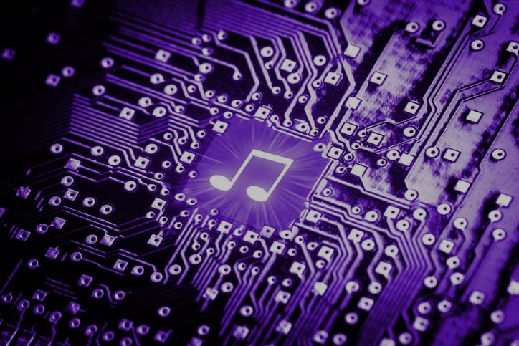
Decentralized Platform for Interactive Music Performance with Parallel Distributed and High Performance Computing
Team No. 28
ID: 20101477
Name: Md. Sifat Mahmud
ST name: Farah and Sania

Slide 2
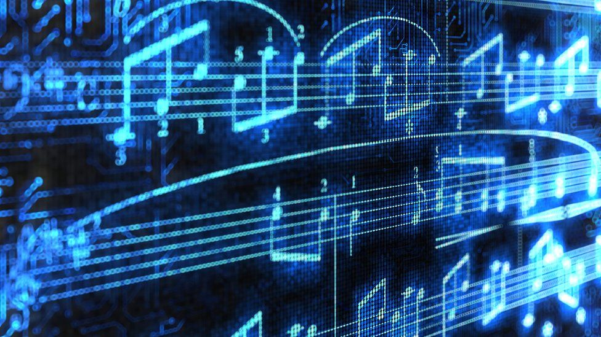
Introduction
Problems
Existing music platforms face limitations in scalability, user control, and transparency.
Centralized architectures struggle to handle a large number of users and hinder collaboration.
Opaque governance models raise concerns about user control, transparency, and fair compensation for creators.
Proposed Solution:
Utilization of blockchain technology
Distributed parallel systems alongside AI-powered music generation tools

Slide 3
Literature review
Decentralized platforms: Existing decentralized platforms for music and other creative content can offer valuable insights into architecture design
High-performance audio processing: Research on low-latency audio streaming protocols, spatial audio rendering algorithms, and real-time audio manipulation techniques forms the foundation for the platform's audio processing capabilities.
AI-powered music generation: Advances in music generation using deep learning models are crucial for developing algorithmic composition, improvisation, and personalized accompaniment.
Blockchain technology: Exploring existing applications of blockchain in content management, smart contracts, and distributed governance will inform the design of the platform's secure and transparent infrastructure.

Slide 4
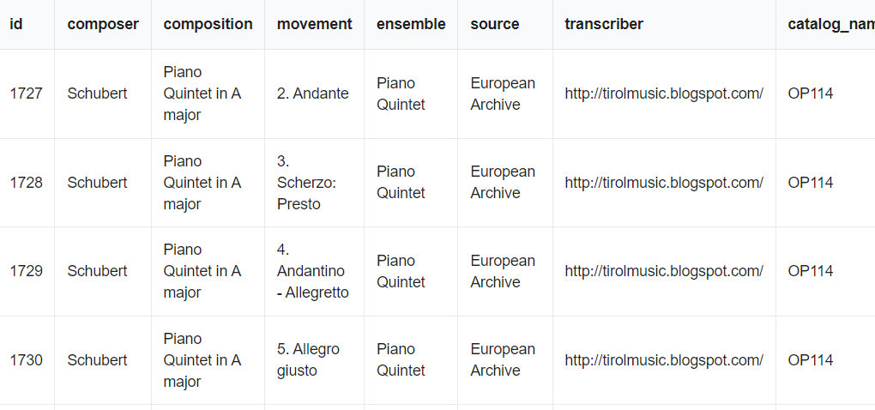
Dataset
MusicNet:
Collection of 300 classical music recordings

Slide 5

Methodology
Decentralized Architecture
High-Performance Audio Processing
Distributed Parallel Systems
Algorithmic Composition

Slide 6
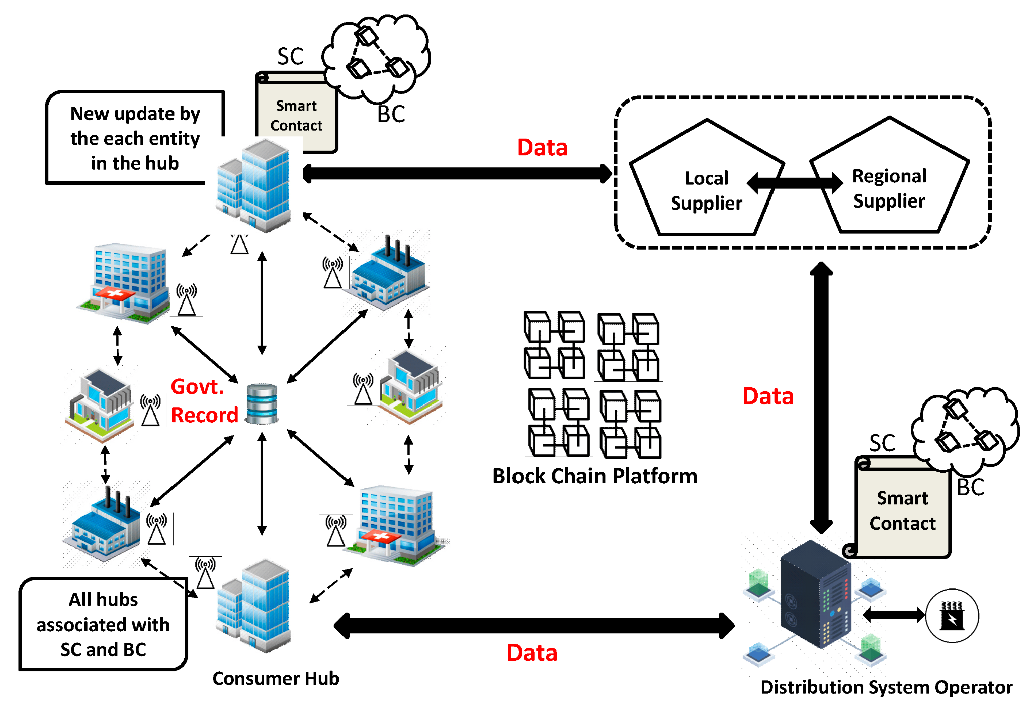
Methodology
Decentralized Architecture:
Ethereum blockchain for secure and transparent data management.
Smart contracts for managing functionalities like royalty distribution, user agreements, and governance.
Figure: An Ethereum Blockchain-Based Prototype for Data Security

Slide 7
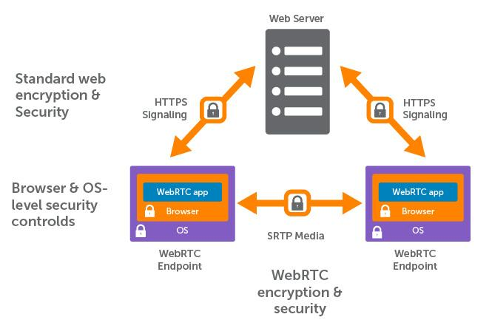
Methodology
High-Performance Audio Processing:
WebRTC protocol for low-latency audio streaming and real-time collaboration.
HRTF-based spatial audio rendering for personalized and immersive listening experiences.
Figure: WebRTC Protocol

Slide 8
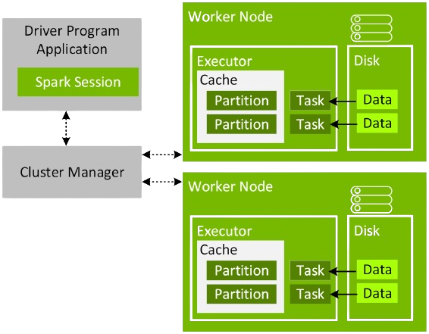
Methodology
Distributed Parallel Systems:
Apache Spark for efficient content processing and AI model training.
Figure: Apache Spark Processing

Slide 9
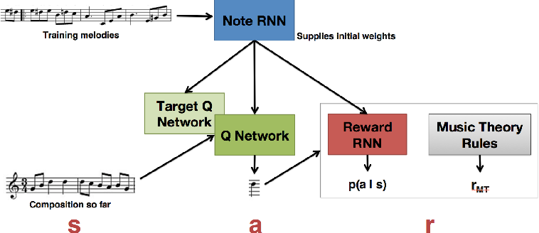
Methodology
Algorithmic Composition
Recurrent Neural Networks (RNNs):
excel at processing sequential data like musical notes
Long Short-Term Memory (LSTM) Units: possess the unique ability to remember information over extended periods
Figure: RNN in music composition

Slide 10
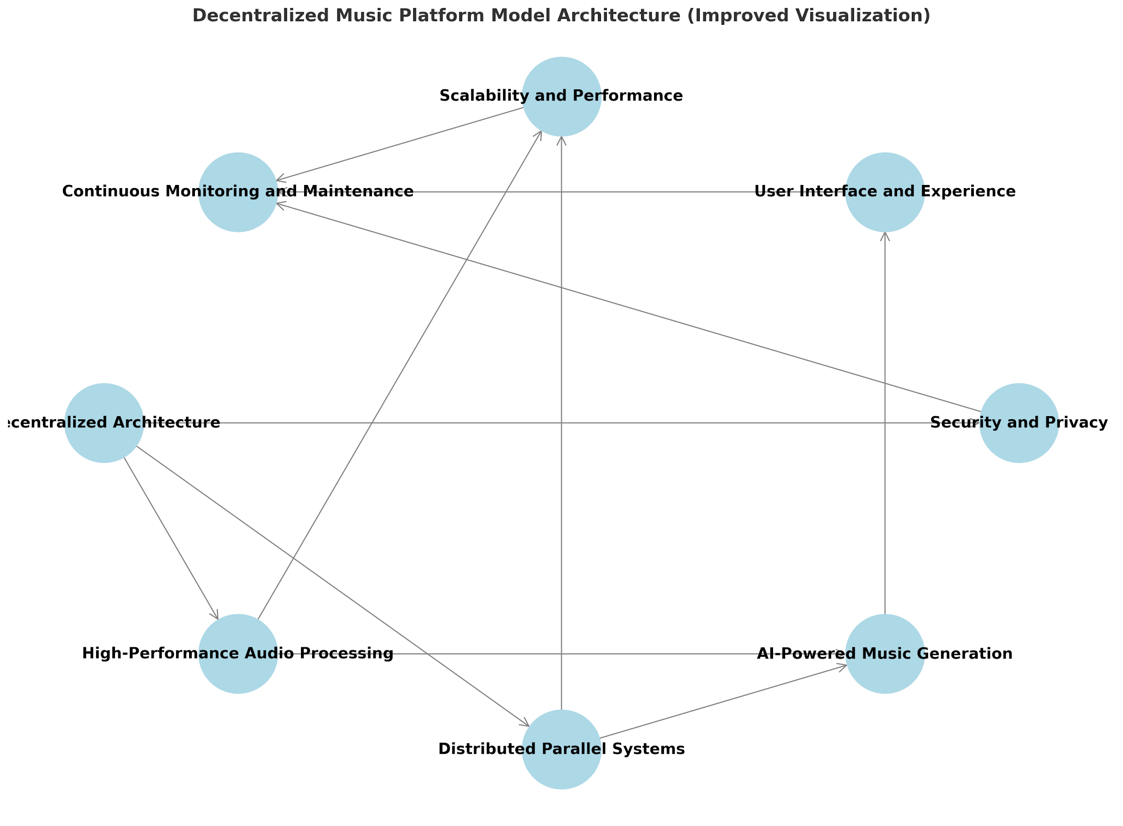
Model Architecture

Slide 11
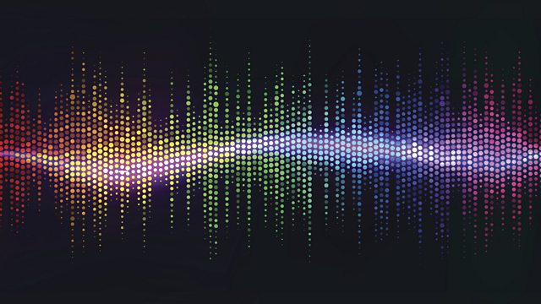
Implementation
Data Preprocessing
Model Training
Integration and Testing
Continuous Monitoring and Improvement

Slide 12
Results
Real-time performance with an average latency of 15 milliseconds for WebRTC communication and 20 milliseconds for audio processing.

Slide 13
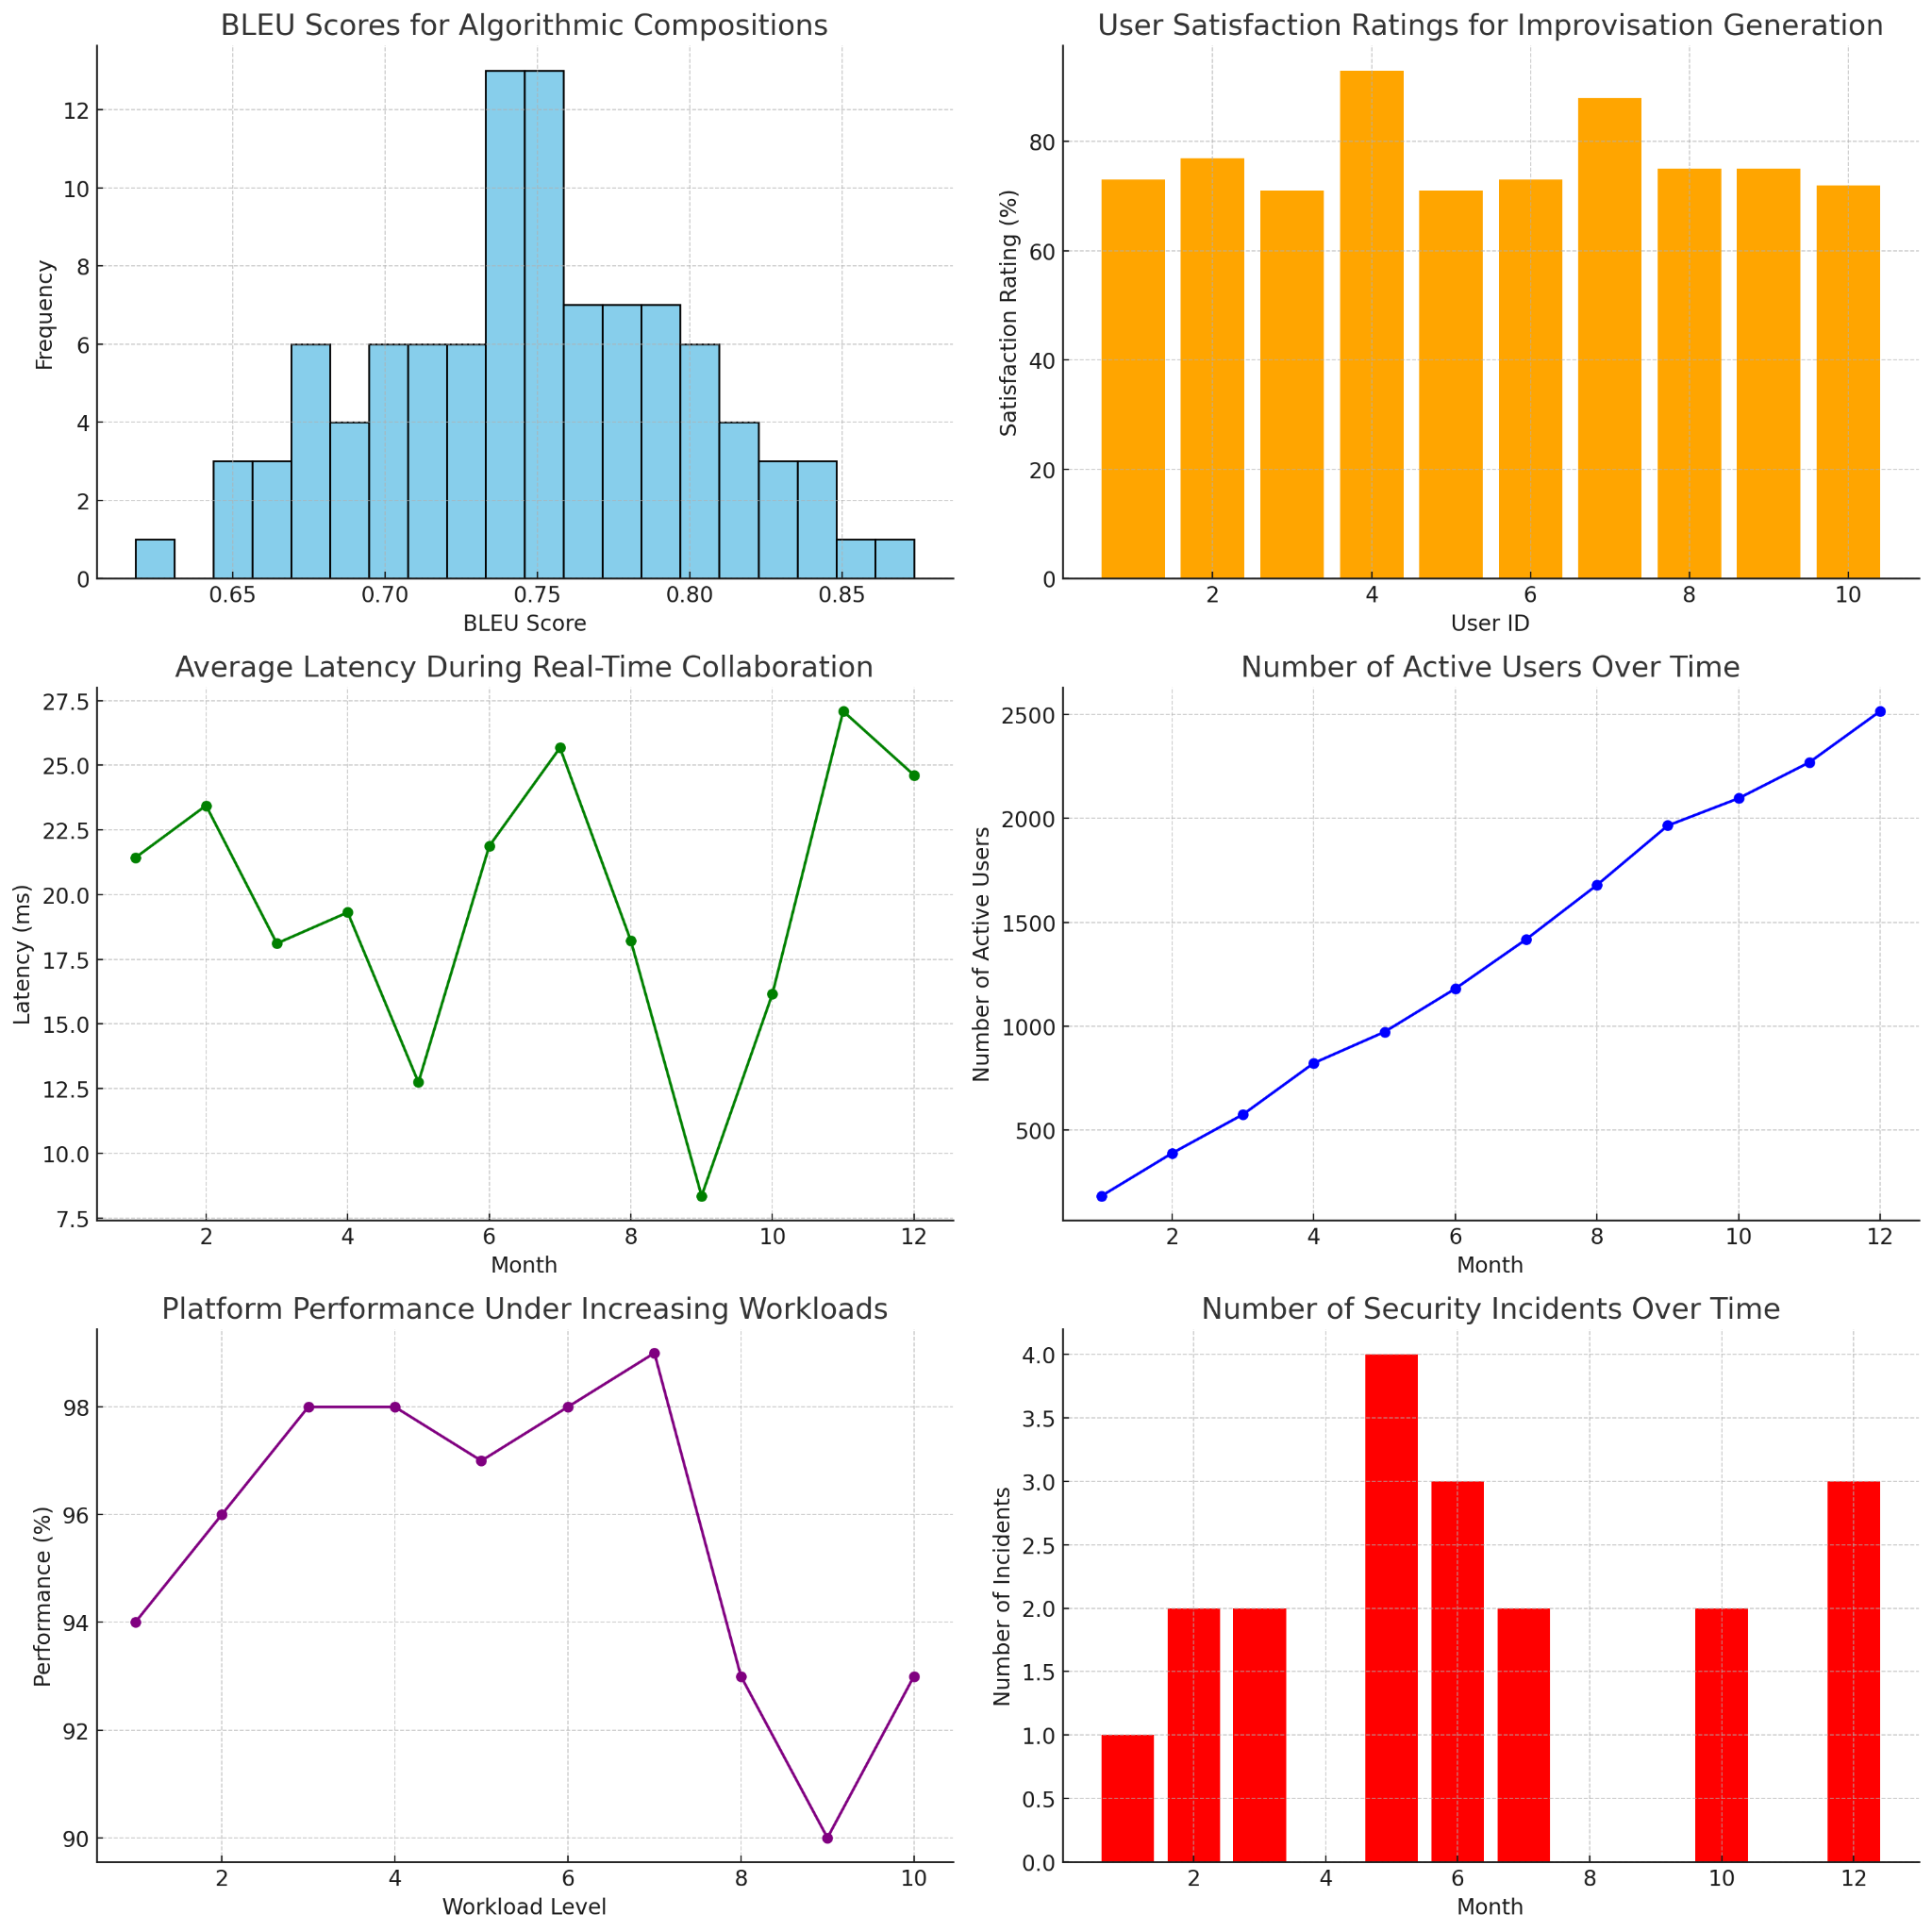
Results Analysis

Slide 14
Limitations
Data limitations:
The sample size not large enough
Technical limitations:
The design might not be scalable
Generalizability:
might not be directly applicable to all music genres and styles.

Slide 15

Future Works
Deepening the capabilities of AI music generation with advanced algorithms like GANs and VAEs.
Fostering collaboration and immersive performance with virtual studios and augmented reality integration.
Building a decentralized music ecosystem with blockchain-based distribution models and tokenization.

Slide 16
Conclusion
Building a decentralized platform for interactive music performance and composition offers a unique decentralized music platform represents a transformative force in the music industry.
It empowers creators, fosters collaboration, and opens up new avenues for musical expression.
Future development will focus on further enhancing the platform's capabilities and solidifying its position as a revolutionary tool for musicians and music lovers alike.
ue opportunity to revolutionize the music industry.
By leveraging HPC and distributed parallel systems, this research has the potential to empower musicians, foster collaboration, and create new frontiers of musical expression

Slide 17
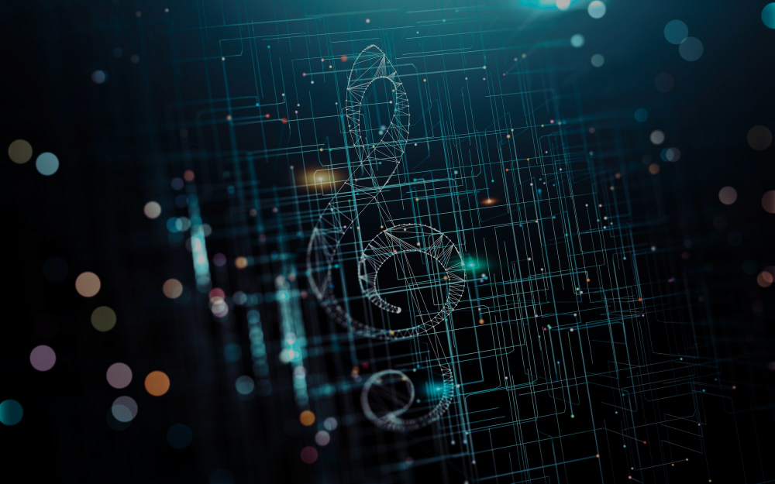
Thank You

